Slide 1
Lecture 3
Recurrences

Slide 2
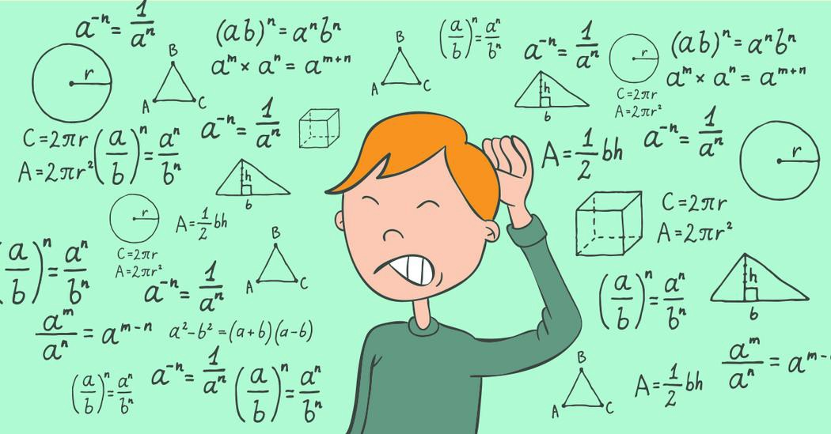
Recurrences
An equation or inequality that describes a function in terms of its value on smaller inputs.
Ex: T(n) = T(n-1) + n
A recurrence relation is a rule for finding future values from previous values.
Recurrences arise when an algorithm contains recursive calls to itself.

Slide 3
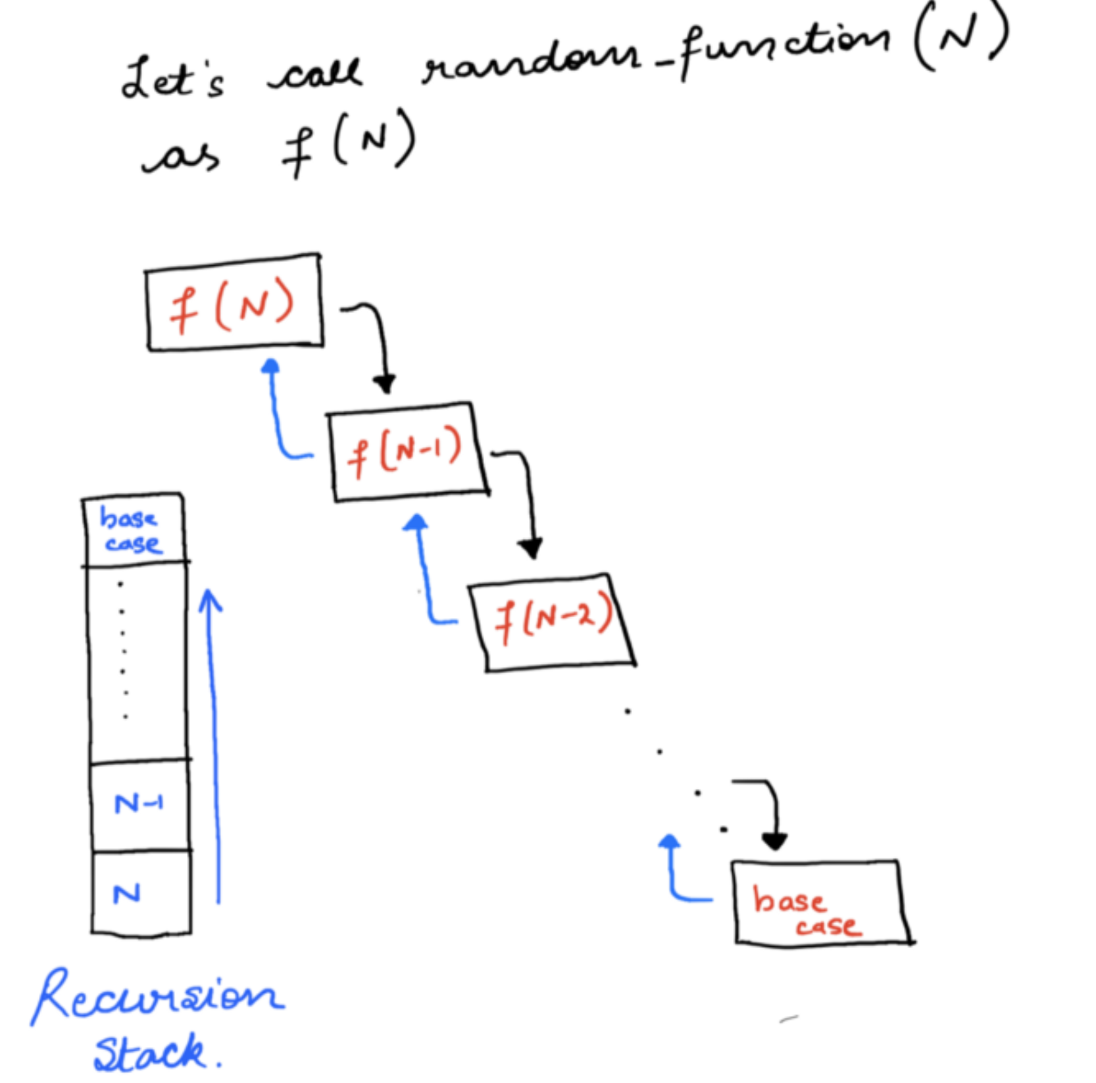
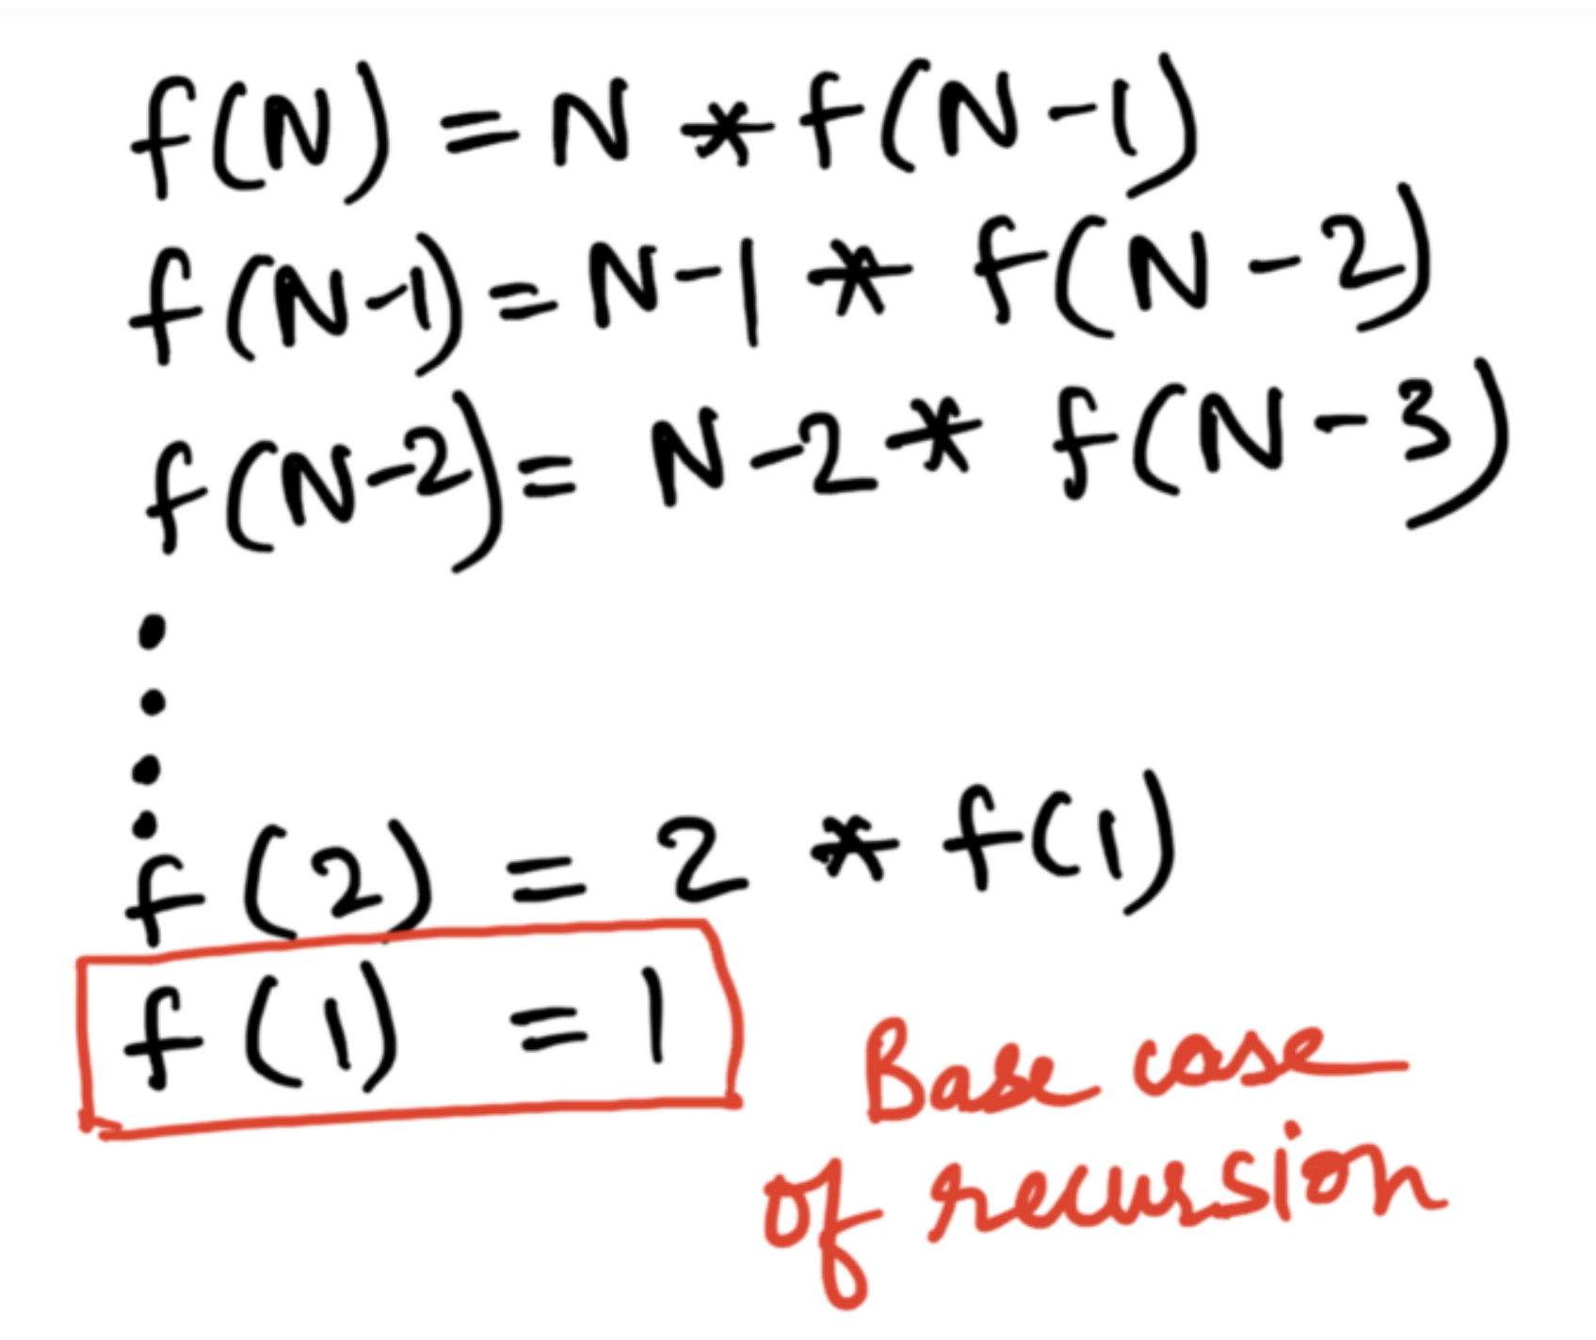
Example: Factorial of a number

Slide 4
Representing recursive problems
Recurrence Relation
A relation defining the states of the problem and how the main problem can be broken down into smaller sub-problems.
Recursion
Tree
showcases the first few, if not all calls to the function under consideration
This also includes the base case for stopping the recursion.

Slide 5

In Class Practice
Q. What is recurrence relation for binary search algorithm?

Slide 6
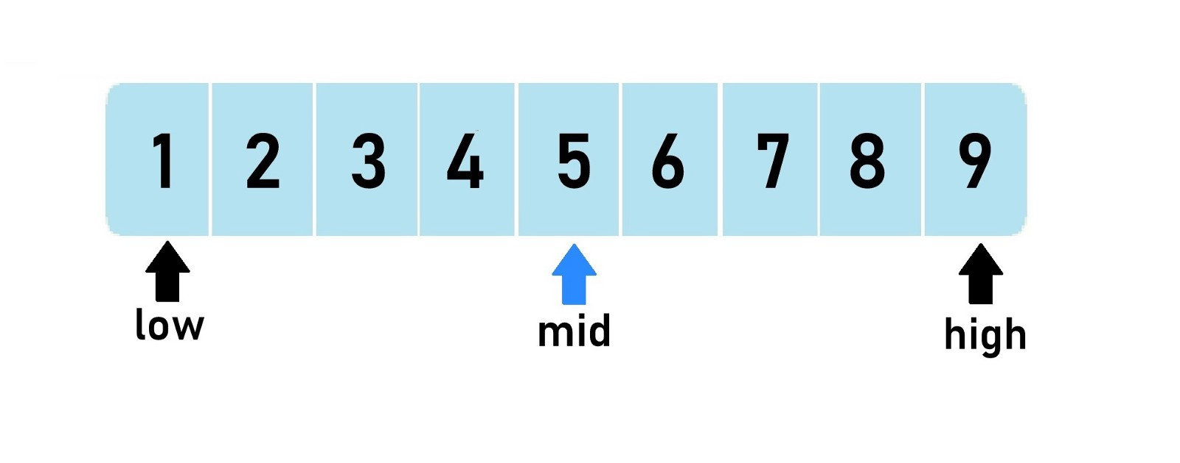
Solution
Binary Search is called on a sub-array of length approximately N/2 and there are 3
comparisons in the worst case before a recursive call is needed again.
So the recurrence relation is:
T(n) = T(n/2) + 3

Slide 7
How to solve recurrence relations??
Substitution method
Recurrence Tree
Master method

Slide 8

Substitution method
Guess the form of the solution.
Verify by induction.
Solve for constants.

Slide 9
Substitution method: Example

Slide 10
Solution
Recurrence Relation: T(n) = 2T(n/2) +n
First Iteration: T(n/2) = 2T( (n/2) / 2) + 2 = 2T( n/4 ) + 2
Substituting the value in original equation:
T(n) = 2T(n/2) + 2
= 2( 2T( n/4 ) + 2) + 2
= 4T(n/4) + 4 + 2
T(n) = 4T(n/4) + 4 + 2

Slide 11
Second iteration
Second Iteration: T(n/4) = 2T( (n/4) / 2 ) + 2 = 2T(n/8) + 2
Substituting the value:
T(n) = 4T(n/4) + 4 + 2 = 4(2T(n/8) + 2) + 4 + 2 = 8T(n/8) + 8+ 4 + 2
T(n) = 8T(n/8) + 8+ 4 + 2

Slide 12
Third iteration
Third Iteration: T(n/8) = 2T( (n/8) / 2 ) + 2 = 2T(n/16) + 2
Substituting the value:
T(n) = 8T(n/8) + 8+ 4 + 2 = 8(2T(n/16) + 2) + 8+ 4 + 2 = 16T(n/16)+16 + 8+ 4 + 2
T(n)= 16T(n/16)+16 + 8+ 4 + 2

Slide 13
Fourth iteration
Fourth Iteration: T(n/16) = 2T( (n/16) / 2 ) + 2= 2T(n/32) + 2
Substituting the value:
T(n) = 16T(n/16)+16 + 8+ 4 + 2 =16(2T(n/32) + 2)+16 + 8+ 4 + 2 = 32T(n/32)+ 32 +16 + 8+ 4 + 2
T(n)= 32T(n/32)+ 32 +16 + 8+ 4 + 2

Slide 14
Finding the general equation
When k=1, we had T(n) = 2T(n/2) + 2
When k=2, we had T(n) = 4T(n/4) + 4 + 2
When k=3, we had T(n) = 8T(n/8) + 8+ 4 + 2
When k=4, we had T(n) = 16T(n/16)+16 + 8+ 4 + 2
When k=5, we had T(n) = 32T(n/32)+ 32 +16 + 8+ 4 + 2
General equation : T(n) = 2^k * T(n/ (2^k) )+ 2 *(2^k - 1)

Slide 15
Stopping criteria
We must now get our T(n) function from our general form to stop, therefore
T(n/(2^k))=C
n/(2^k) = 1
k= log₂n
Substituting value of k in general equation
T(n) = 2^(log₂n) * T(n/ (2^(log₂n)) )+ 2 *(2^(log₂n) - 1)
T(n) = n * T(n/n) + 2( n -1) T(n) = n T(1) + 2n – 2 (Given T(1)=1) T(n) = n + 2n - 2 T(n) = 3n - 2
T(n)= O(n)

Slide 16

In class Practice
Q1: Solve the following recurrence equations using substitution method:
3T(n-1), if n>0,
1, otherwise
2T(n-1) - 1, if n>0,
1, otherwise
a) T(n) =
b) T(n) =

Slide 17
Solutions
Solution:
a) Let us solve using substitution.
T(n) = 3T(n-1)
= 3(3T(n-2))
= 3²T(n-2)
= 3³T(n-3)
...
...
= 3^{n}T(n-n)
= 3^{n}T(0)
= 3^{n}
This clearly shows that the complexity
of this function is O(3^{n}).

Slide 18
b) Let us try solving this function with substitution.
T(n) = 2T(n-1) - 1
= 2(2T(n-2)-1)-1
= 2²(T(n-2)) - 2 - 1
= 2²(2T(n-3)-1) - 2 - 1
= 2³T(n-3) - 2² - 2¹ - 2⁰
.....
= 2^{n}T(n-n) - 2^{n-1} - 2^{n-2} - 2^{n-3}..... 2² - 2¹ - 2⁰
= 2^{n} - 2^{n-1} - 2^{n-2} - 2^{n-3} ..... 2² - 2¹ - 2⁰
= 2^{n} - (2^{n}-1) [Note: 2^{n-1} + 2^{n-2} + ...... + 2⁰ = 2^{n} ]
T(n) = 1
Time Complexity is O(1).

Slide 19

Recursion Tree Method
A recursion tree is used to present a problem as a composition of sub-problems.
Each node represents the cost of a single sub-problem.
Usually each level of the tree corresponds to one step of the recursion.

Slide 20
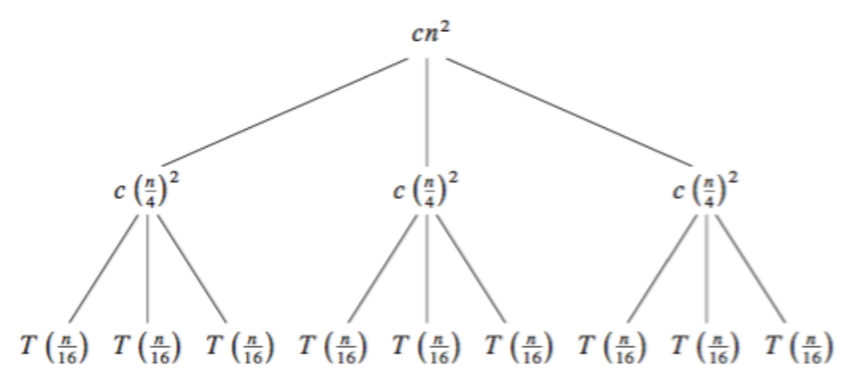
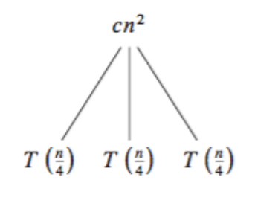

Recursion Tree Method: Example
Recurrence relation: T(n) = 3T(n/4) + Θ(n²)

Slide 21
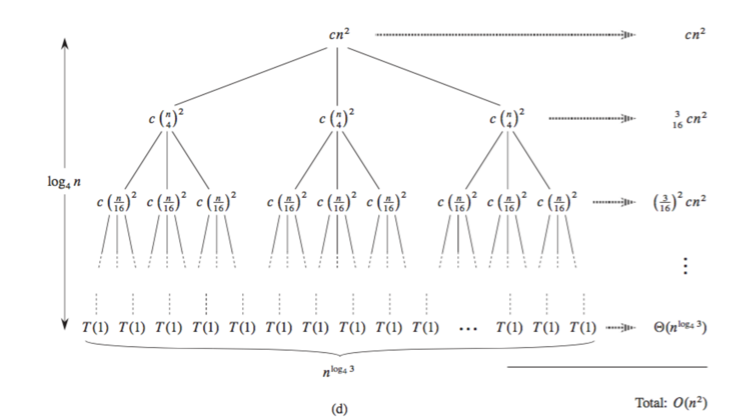
Final recursive tree

Slide 22
In Class Practice
Q: Solve the following recurrence relations using recursion tree method:
a) T(n) = T(n/3) + T(2n/3) + cn.
b) T(n) = T(n/5) + T(4n/5) + n

Slide 23
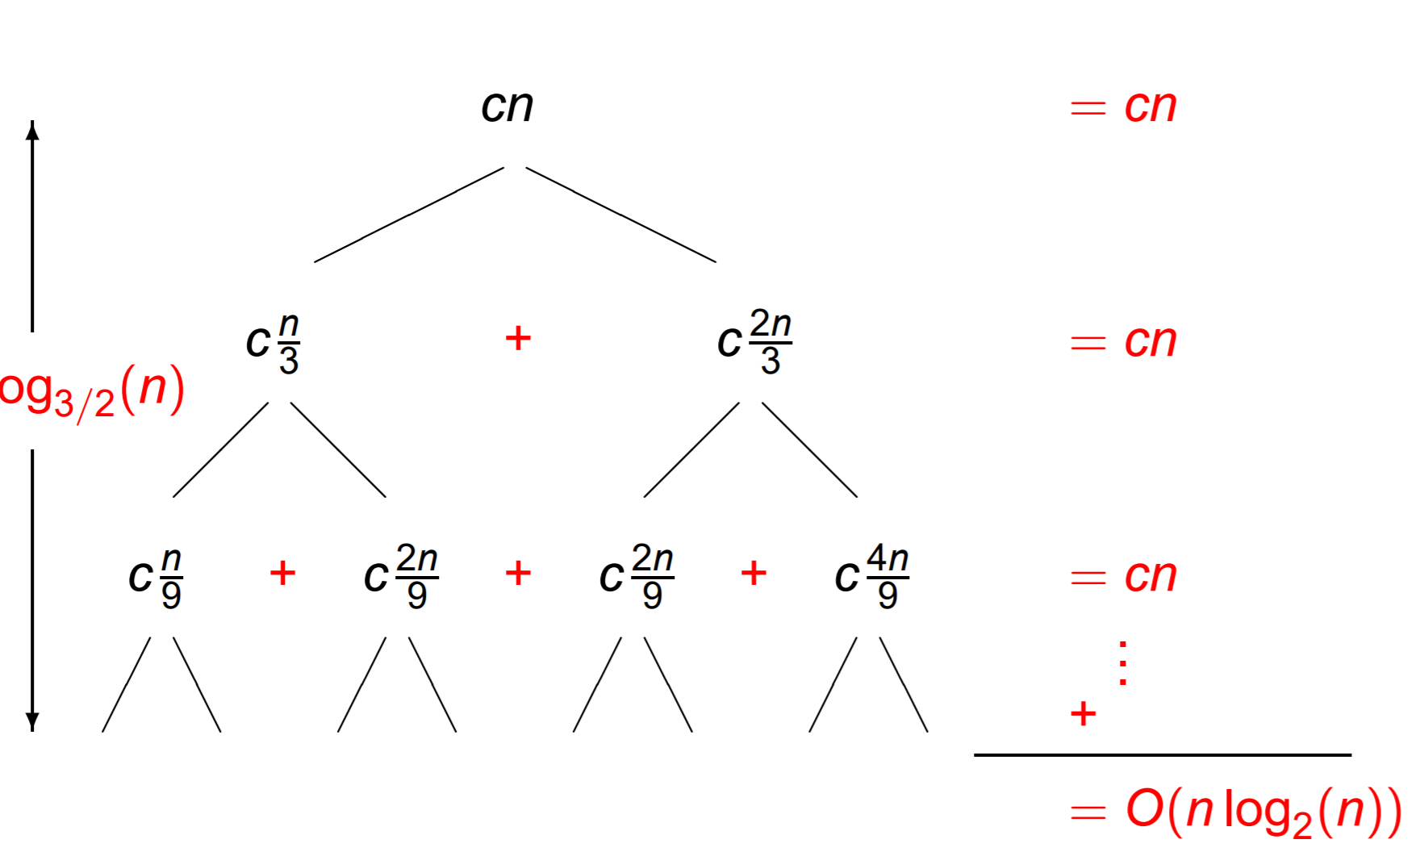
Solutions
a)

Slide 24
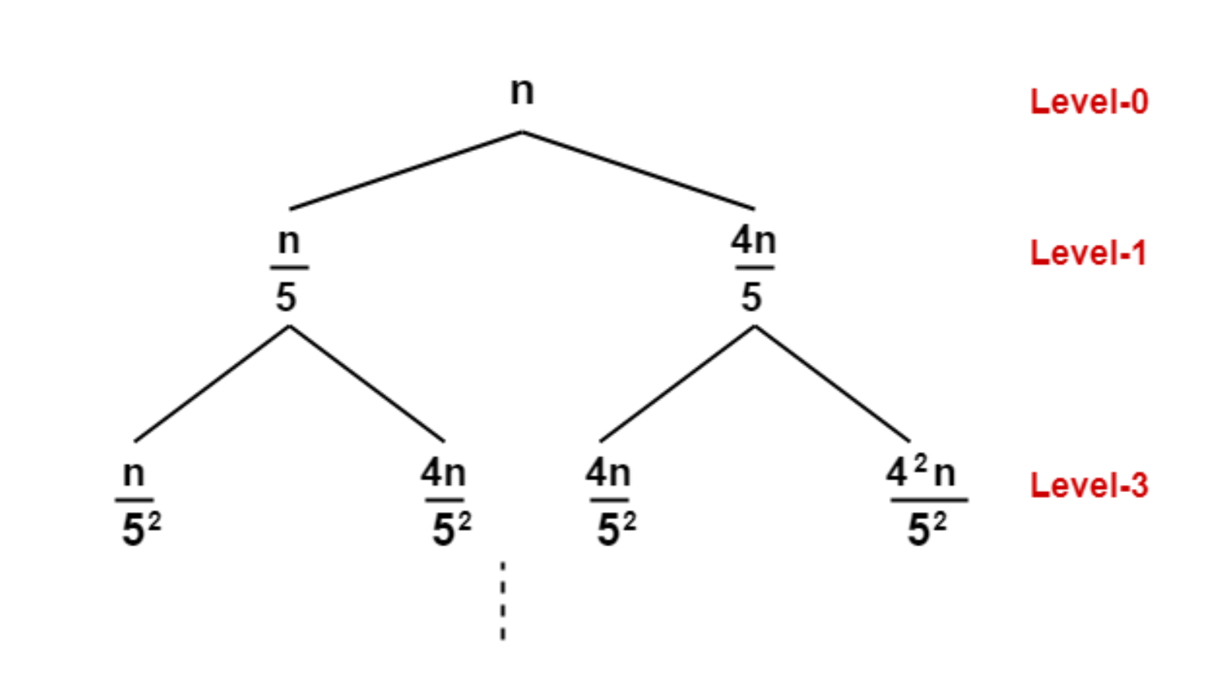
b)
θ(nlog_{5/4}n)

Slide 25
Master method
The master theorem is a formula for solving recurrences of the form:
T(n) = aT(n/b) +f(n), where a ≥ 1 and b > 1 and
f(n) is asymptotically positive.
Arise often in divide and conquer problems
n = Problem size
a= number of sub-problems n can be divided into.
b= factor by which each sub-problem is divided at each level.
f(n)= time of divide and combine steps

Slide 26
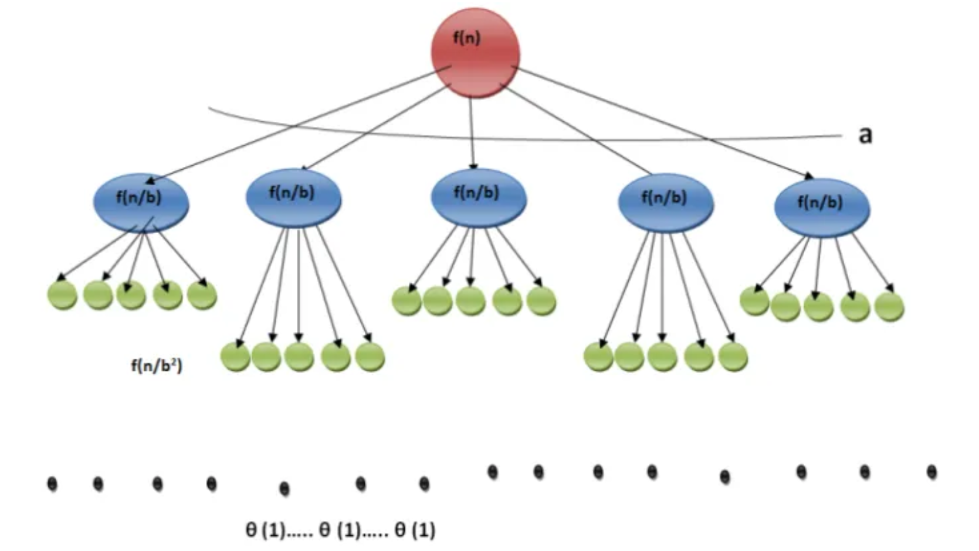

Slide 27
Conditions for master method
If f(n) = Θ(n^{c}) where c < Log_{b}a then T(n) = Θ(n^{Log}_{b}ª)
If f(n) = Θ(n^{c}) where c = Log_{b}a then T(n) = Θ(n^{c}Log n)
If f(n) = Θ(n^{c}) where c > Log_{b}a then T(n) = Θ(f(n))

Slide 28
Example 1
Recurrence Relation: T(n) = 9T(n/3) + n
Solution:
Given: a=9, b=3, f(n) = n, c=1
Calculate log_{b} a = log₃ 9 = 2
Case 1 applies: c < log_{b}a
Thus the solution is T(n) = Θ(n²)
CASE 1

Slide 29
Example 2
Recurrence Relation: T (n) = 2T (n/2) + n log n
Solution:
Given: a=2, b=2, f(n) = nlogn, c=1
Calculate log₂ 2 = log₂ 2 = 1
Case 2 applies: c = log_{b}a
Thus the solution is T(n) = Θ(nlogn)
CASE 2

Slide 30
Example 3
Recurrence Relation: T (n) = 2T (n/4) + n^{0.51}
Solution:
Given: a=2, b=4, f(n) = n^{0.51}, c = 0.51
Calculate log₄ 2 = log₄ 2 = 0.50
Case 3 applies: c > log_{b}a
Thus the solution is T(n) = Θ(n^{0.51})
CASE 3

Slide 31

In class Practice
T(n) = 3T (n/2) + n²
T(n) = 4T (n/2) + n²
T(n) = T (n/2) + 2^{n}
T (n) = 2^{n}T (n/2) + n ^{n}
T (n) = 16T (n/4) + n
T (n) = √ 2T (n/2) + log n

Slide 32
Solutions
T(n) = 3T (n/2) + n ² ⇒ T (n) = Θ(n² ) (Case 3)
T (n) = 4T (n/2) + n² ⇒ T (n) = Θ(n² log n) (Case 2)
T (n) = T (n/2) + 2^{n} ⇒ Θ(2^{n} ) (Case 3)
T (n) = 2^{n}T (n/2) + n ^{n} ⇒ Does not apply (a is not constant)
T (n) = 16T (n/4) + n ⇒ T (n) = Θ(n² ) (Case 1)
T (n) = √2T (n/2) + log n ⇒ T (n) = Θ(√n) (Case 1)

